Slide 1
Lecture 26
November 4th , 2019
  Look carefully. Choose a fly vial for you and your partner. If one of your originals is there, choose it. If not, choose another and label.
  This week, some will need to clear out parent flies so as F1 emerge, we are not mistakenly analyzing parents or mating parents with F1. As soon as you see pupae, do this.
  The next cross is easier as we basically take the F1 males and females and let them do their thing! The final analysis will be of the F2 offspring.

Slide 2
Where were we?…
  Imprinting—the result of epigenetic modification of some genes during gamete formation
  Pleiotropy—Mutation in one gene leading to multiple abnormal phenotypes. Marfan Syndrome one example. PKU, Albinism….other examples. It means the protein is important in cells of many tissues.

Slide 3
Complementation analysis

Slide 4
When one is studying a suspected genetic variant/abnormality, the mutants may show one variation, but may reveal multiple genes are involved in producing the normal phenotype….
To determine the number of genes controlling a particular phenotype, we might use a genetic test called complementation analysis.
  Allows us to test whether two independently isolated mutants (same phenotype) are due to mutations in the same or in different genes.
  Each time we see a new/different gene, we can add it to the number of genes controlling the phenotype.
Notes:
4

Slide 5
Possible outcomes…
Offspring are wild-type (winged). Means the mutations covered or complemented each other. Each fly provided a wild-type of allele of the other’s mutation.
---Mutations must have been in different genes.

Slide 6
Offspring are still mutants (wingless). Means the mutations did not complement each other. The offspring fly received a mutant form of the same gene from each parent. They have the same genetic defect as the parent.
---Mutations must have been in same gene.
**mutations need not be exactly the same, but within the same gene, affecting the same gene product.

Slide 7
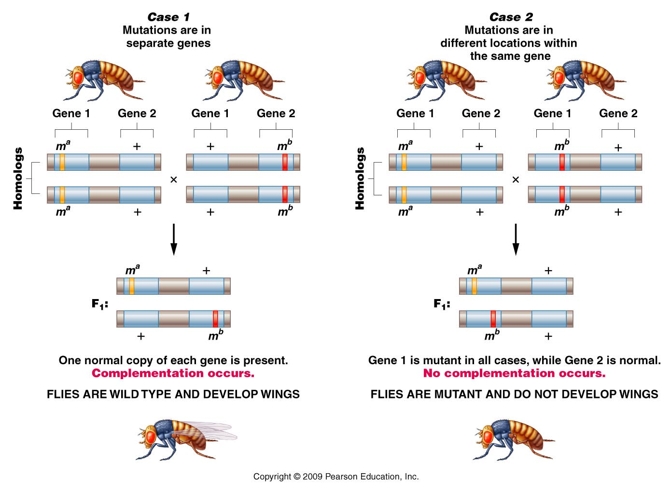
Figure 4.11
Notes:
7
Figure 4-11 Complementation analysis of alternative outcomes of two wingless mutations in Drosophila (mª and m^{b}). In Case 1, the mutations are not
alleles of the same gene, while in Case 2, the mutations are alleles of the same gene.

Slide 8
Figure 4.11
Notes:
8
Figure 4-11 Complementation analysis of alternative outcomes of two wingless mutations in Drosophila (mª and m^{b}). In Case 1, the mutations are not
alleles of the same gene, while in Case 2, the mutations are alleles of the same gene.

Slide 9
Important points!
The example makes it appear that genes for wing development would all be on the same chromosome….not true…just an easy way to show the concept…
**Complementation analysis only works for recessive traits!
Complementation analysis allows us to determine the number of genes involved in controlling a specific phenotype.
  # genes often referred to as # of complementation groups.

Slide 10
Chapter 5 – Linkage/Crossing over/ Chromosome mapping
We have spent much time studying one or a small number of genes contributing to specific traits:
  e.g. Isoagglutinogen gene---blood type

Slide 11
Of course each of our genes is located on a specific chromosome with many other genes physically linked to the same chromosome.

Slide 12
Who first described linkage…
Thomas Morgan---X-linked genes (white eye mutation).

Slide 13
Human chromosomes
23 different chromosomes
  Human Genome Project sequenced each of them. Estimate ~20,000-30,000 protein coding genes
  Average ~1300 genes/chromosome

Slide 14
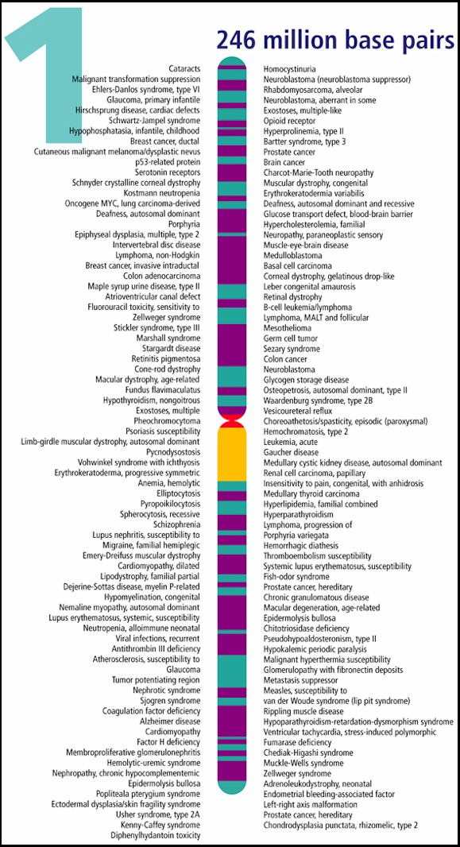
Example---genes mapped to chromosome 1

Slide 15
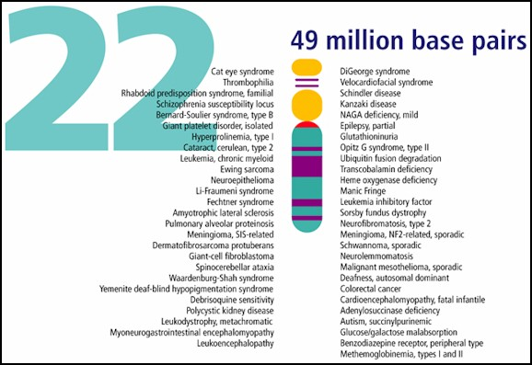
Genes mapped to human chromosome 22

Slide 16
Let’s begin by comparing independently assorting genes with linked genes
  Familiar example: color and texture in corn kernels
  Yellow (aa) sweet (bb)
  vs vs.
  Purple (A_) Starchy (B_)

Slide 17
In our lab we assumed 2 unlinked genes controlled these 2 traits
F2 offspring showed classic ratio of independent assortment
9 A_B_ Purple/starchy
3 A_bb Purple /sweet
3 aaB_ yellow/starchy
1 aabb yellow/sweet

Slide 18
What if the A locus and B locus were on the same chromosome. What do you expect?
--on white board…

Slide 19
What if the A locus and B locus were on the same chromosome. What do you expect?
--on white board…Do cross of a heterozygote AaBb X AaBb
A
a
A
a
B
b
B
b

Slide 20
This is an example of complete linkage.
  Complete linkage is actually quite rare---Why?
    During gamete formation, alleles on homologous chromosomes can switch places during crossing over / recombination. In a sense 2 alleles can become separated from each other, but not by independently assorting.

Slide 21
This is an example of complete linkage.
Review figure 5-2 for a case of complete linkage in Drosophila.
They show the results of a testcross with 2 completely linked genes.

Slide 22
Visualize what occurs during crossing over.
  F1 heterozygote
  Production of gametes
  Possibilities of offspring and expected frequencies.
  on board….

Slide 23
Thomas Morgan (remember him?) and his student, Alfred Sturtevant, were the first to really describe crossing over when while studying X-linked genes.
Morgan looked at X-linked genes 2 at a time.
e.g. yellow body and white eyes
white eyes and miniature

Slide 24
Noted they appeared to be unlinked some of the time, forming new combinations in a small proportion F2 offspring.
e.g. in crosses analyzing yellow body and white eyes, about 0.5% of the offspring showed the y allele and the w allele apparently switching places during gamete formation.
(99.5% of the time the alleles did not swap places) (Figure 5-3)

Slide 25
Oddly, other pairs of X-linked genes recombined at different frequencies.
in crosses analyzing white eyes and miniature phenotype, about 34.5% of the offspring showed the w allele and the m allele apparently switching places during gamete formation.
(65.5% of the time the alleles did not switch) (Figure 5-3)

Slide 26
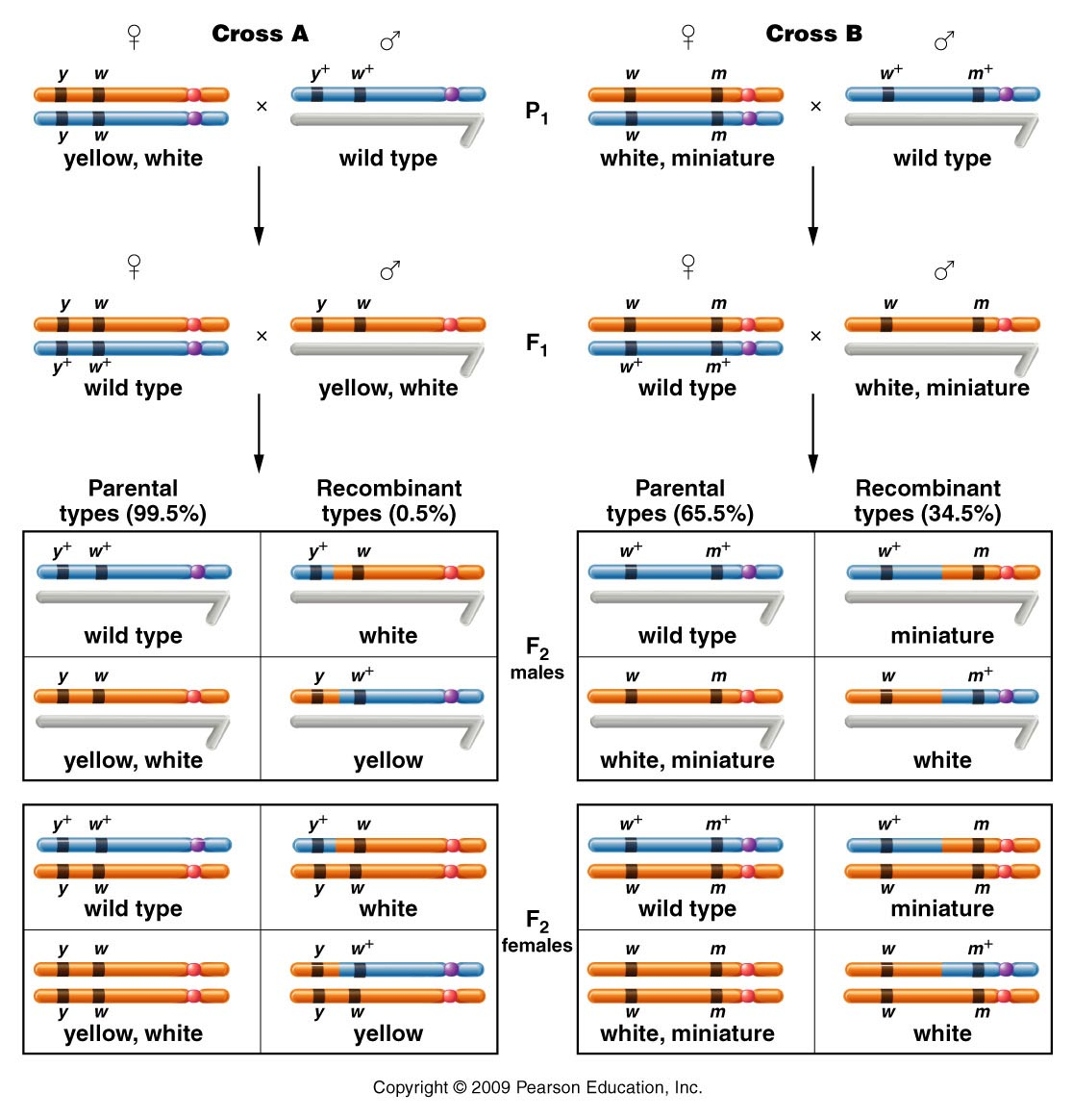
Figure 5.3
Notes:
26
Figure 5-3 The F1 and F2 results of crosses involving the yellow-body, white-eye mutations and the white-eye, miniature-wing mutations. In cross A, 1.3 percent of the F2 flies (males and females) demonstrate recombinant phenotypes, which express either white or yellow. In cross B, 37.2 percent of the F2 flies (males and females) demonstrate recombinant phenotypes, which are either miniature or white mutants.

Slide 27
Important observation…
A dihybrid cross involving linked genes will usually result in 4 different combinations of traits, but not give a 9:3:3:1 ratio of offspring.
These 2 genes definitely did not appear to assort independently—different ratios were seen—different in every gene pair examined as well.

Slide 28
Sturtevant’s conclusion:
1) linked genes do physically separate as a result of crossing over during meiosis
2) Different crossing over/recombination frequencies reflect physical distances between loci.
3) Closely spaced genes are less likely to undergo crossing over.

Slide 29
Distances determined by recombination frequencies are not actual physical distances, but do reflect relative distances between genes.
Units are centiMorgans (cM) or map units (mu)

Slide 30
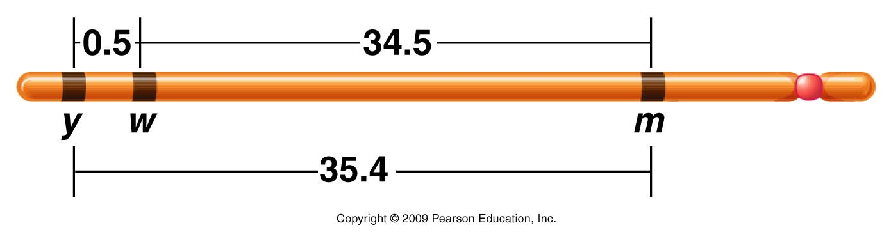
Morgan’s data was used to create a map showing the relative distance between the genes.
Aa
**The two, 2-point crosses would not show order, unless all combinations of genes were analyzed.
Figure 5.4
Notes:
Figure 5-4 A map of the yellow (y), white (w), and miniature (m) genes on the X chromosome of Drosophila melanogaster. Each number represents the percentage of recombinant offspring produced in one of three crosses, each involving two different genes.

Slide 31
Quick summary…linked genes
We’ve defined linked genes.
We’ve noted that independent assortment does not occur, with linked genes.
We’ve noted that linked alleles can separate if crossing over occurs between them.

Slide 32
Crossover occurs more frequently, the farther apart 2 genes are on the same chromosome.
A b C
a B c

Slide 33
The frequency in which crossover is noted, becomes a recombination gene distance (in cM or mu
A b C
a B c
Perhaps we see recombinant offspring due to a-b crossover 2% of the time and b-c, 35 % of the time.

Slide 34
The frequency in which crossover is noted, becomes a recombination gene distance (in cM or mu)
        A b C
        a B c
2 cM
35 cM

Slide 35
Note---Crosses must be carefully designed to be able to observe crossing over. (X-linked traits simplify the analysis)
  1 parent must be heterozygous
  1 parent must provide only recessive alleles so that new combinations of wt/recessive traits are evident.

Slide 36
Heterozygous female
Male with only recessive alleles
Figure 5.3
Notes:
Figure 5-3 The F1 and F2 results of crosses involving the yellow-body, white-eye mutations and the white-eye, miniature-wing mutations. In cross A, 1.3 percent of the F2 flies (males and females) demonstrate recombinant phenotypes, which express either white or yellow. In cross B, 37.2 percent of the F2 flies (males and females) demonstrate recombinant phenotypes, which are either miniature or white mutants.

Slide 37
Morgan’s crosses were simplified in 2 ways:
  1. Using X-linked crosses in Drosophila meant that crossing over was only possible in females. (2 X chromosomes)
  2. In Drosophila, males do not engage in crossing over at all so looking at recombination of any linked genes is simplified.

Slide 38
Morgan’s student, Alfred Sturtevant saw an immediate application to recombination mapping.
  Determination of linear sequence of genes on a chromosome.

Slide 39
Sturtevant noted that recombination frequencies were approximately additive, allowing the order of genes to be determined.
In 3 separate crosses:
  y-w frequency is 0.5%
  w-m frequency is 34.5
  y-m frequency is 35.4 %

Slide 40
Sturtevant noted that recombination frequencies were approximately additive, allowing the order of genes to be determined.
In 3 separate crosses:
  y-w frequency is 0.5%
  w-m frequency is 34.5
  y-m frequency is 35.4 %
**Which genes are on the outside?
*** Which gene is in the middle?
****Which genes are closest to each other?

Slide 41
Sturtevant’s data was used to create a map showing the relative distance between the genes AND order.
Usually, the further 2 genes are spaced the less accurate recombination mapping becomes (explained later)
Figure 5.4
Notes:
Figure 5-4 A map of the yellow (y), white (w), and miniature (m) genes on the X chromosome of Drosophila melanogaster. Each number represents the percentage of recombinant offspring produced in one of three crosses, each involving two different genes.

